Slide 1
AMAZON E-COMMERCE
Presented by: Naveen H N
Date: 18/01/2025

Slide 2
AGENDA
Introduction
Key Performance Indicators (KPIs)
Data Analysis and Insights
Revenue Distribution
Customer Segmentation
Product Performance
Periodic And Geographical Analysis
Recommendations
Customer Loyalty Programs
Targeted Marketing Strategies
Operational Improvements
Conclusion

Slide 3
Introduction
Overview:
Amazon is a global leader in e-commerce, known for its customer-centric approach and innovative technologies.
The goal is to analyze customer behavior, product performance, and operational efficiency to drive revenue growth and customer satisfaction.
Key Objectives:
Identify high-value customers.
Analyze product performance and delivery efficiency.
Develop strategies to improve customer loyalty and sales.

Slide 4
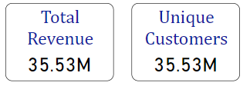
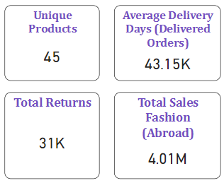
Key Performance Indicators (KPIs)
Key Metrics:
Total Revenue: Sum of sales and shipping fees.
Unique Customers: Number of distinct customers making purchases.
Unique Products: Number of distinct products sold.
Average Delivery Time: Time taken to deliver products.
Customer Satisfaction: Average rating given by customers.

Slide 5
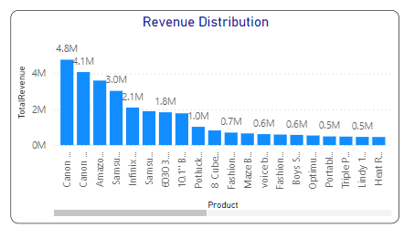
Revenue Distribution Analysis
Insights:
Revenue generated in 2020 was higher compared to previous years.
Top revenue-generating product: Canon EOS 600D 18MP DSLR Camera.

Slide 6
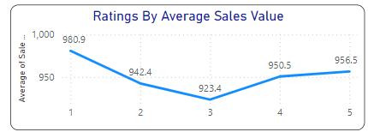
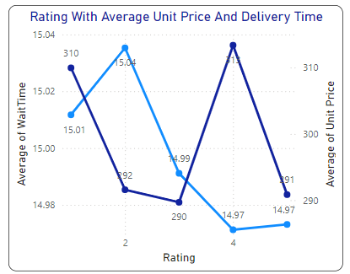
Customer Segmentation and Analysis
Insights:
Age Distribution: Most customers are between 25-45 years old.
Demographic Segmentation: Younger customers prefer trendy products, while older customers focus on quality.
Loyalty Programs: 85.21% of customers spend less, indicating a need for targeted loyalty programs.

Slide 7
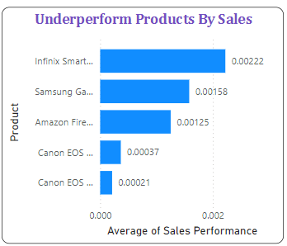
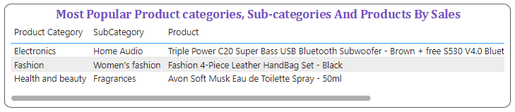
Product Performance Analysis
Most Popular Products: Canon EOS 600D, Apple iPhone 12.
Underperforming Products: Products with low sales and high prices.
Product Trends: Some products show seasonal spikes in sales.

Slide 8
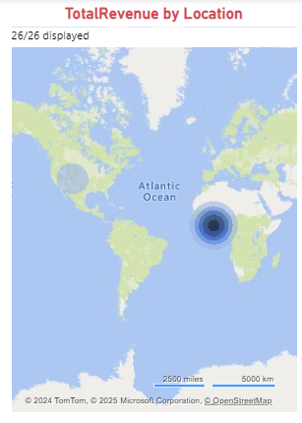
Periodic And Geographical Analysis
Periodic and Geographic analysis will help to devise target marketing and distribution strategies.
Insights:
The average sales value dropped for February, June and September.
North America and African regions are contributing more to revenue.
South America is the least revenue contributing region.

Slide 9
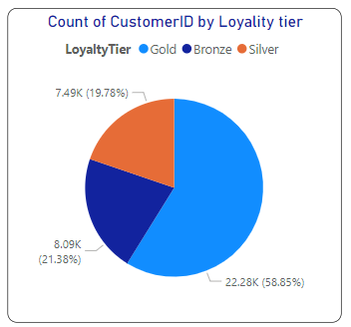
Customer Loyalty Program
Every company go for customer loyalty program to encourage customers engaging them to purchase more.
Insights:
Grouping the customers by their spending value, 85.21% customers spend low compared to others.
Despite their high revenue, these products have low average discount value. Giving discounts to these products will drive sales and revenue.

Slide 10
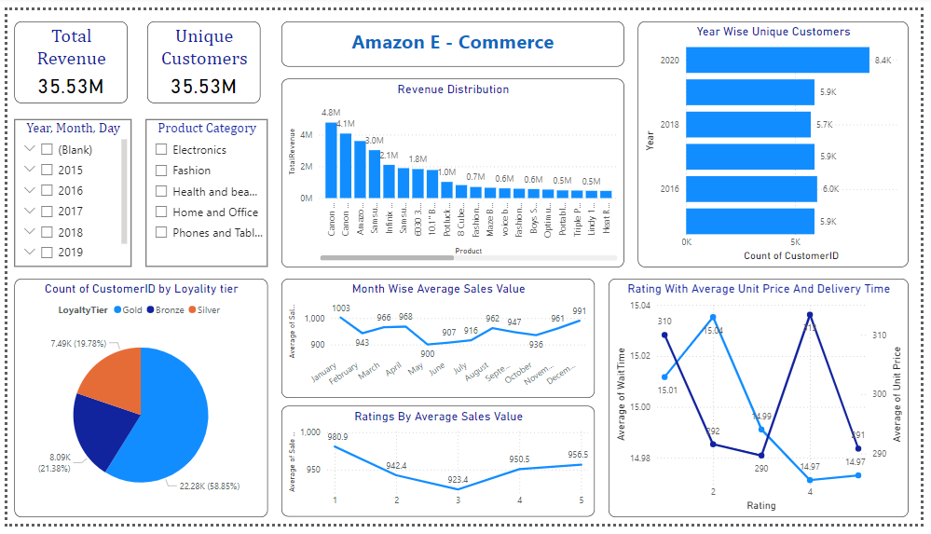
Amazon E- Commerce Main Tab

Slide 11
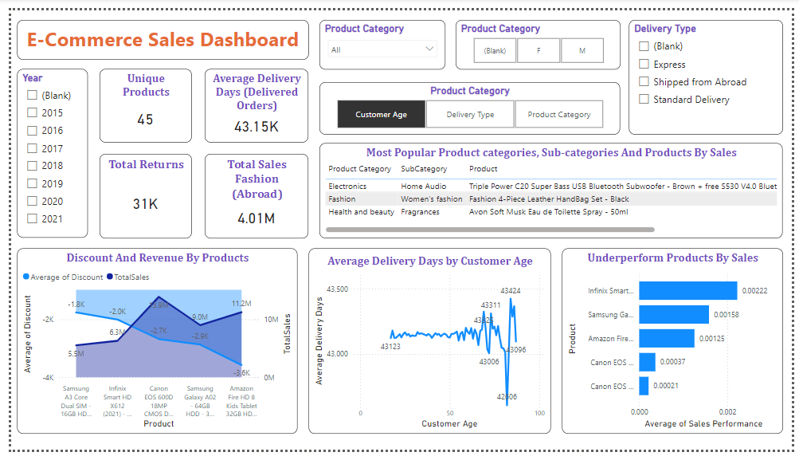
Product Tab

Slide 12
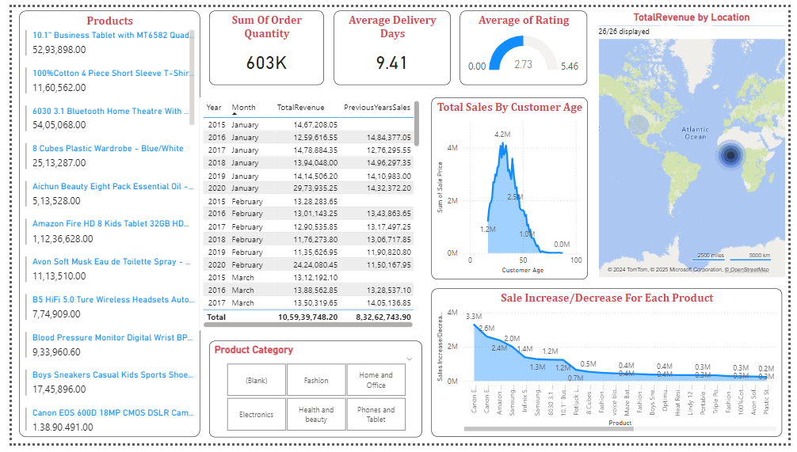
Individual Product Tab

Slide 13
Recommendation
Customer Retention: Introduce loyalty programs with exclusive perks for frequent buyers.
Enhanced Value Proposition: Expand Prime benefits and personalized offers.
Data-Driven Insights: Use data analytics to identify high-value customers and optimize campaigns.
Feedback Utilization: Act on customer feedback to improve service and product quality.
Location-Specific Offers: Focus on location-specific marketing and exclusive collaborations.
Innovative Engagement: Introduce gamification, dynamic pricing, and interactive rewards to boost customer interaction.

Slide 14
Conclusion
Amazon is performing well but needs to focus on maintaining its competitive edge and customer satisfaction.
Identifying high-value customers and providing them with targeted rewards can boost loyalty.
Leveraging data analytics and customer feedback will ensure continuous improvement and enhanced shopping experiences.
Expansion of Prime perks and personalized offerings will keep Amazon attractive to existing and new customers.

